Slide 1
DATA SECURITY AND MANAGEMENT
Team leader – Paramjyot Singh
Team members
Gurleen
Kashish
Yashika
Adnan
Sanpreet singh

Slide 2
data and database
Data refers to raw facts and figures that are structured or unstructured in nature , which are collected , analyzed and summarized for better interpretation and presentation. It can be in the from of different formats such as text , numbers , images , audio or video etc.
A database is a structured collection of data that is organised and managed in a way that allows for efficient storage , retrieval , modification and deletion of data. Some common examples of database include relational database , document-oriented database , key-values stores , graph database , time-series databases etc.

Slide 3
structured query language
SQL (Structured Query Language) is a programming language used to manage and manipulate relational databases. It is a standard language used to access , insert , update and retrieve data from databases. It is supported by many relational database management systems (RDBMS), such as Oracle , MySQL , PostrgresSQL , Microsoft SQL Server etc. It us widely used in web development , data analysis , and other applications where structured data needs to be stored and managed.

Slide 4
data security
Data security is the practice of protecting digital data from unauthorized access , use , theft , destruction , or modification . Data can be sensitive or confidential information such as personal data , financial information , intellectual property or trade secrets , and its protection is crucial to maintain the privacy , integrity and availability of data.
Data security is essential for individuals , businesses , and organizations of all sizes , as a data breach can result in significant financial losses , reputation damage , legal liability and loss of customer trust .

Slide 5
Cia triad
The cia triad is a widely used model in information security that represents the three fundamentals goals of information security: confidentiality , integrity and availability . The acronym of CIA stands for:
Confidentiality: The protection of information from unauthorized access.
Integrity : The protection of information from unauthorized modification , deletion or destruction of data .
Availability: The protection of information from unauthorized denial of access to make sure that is available to only the authorized individuals or system whenever required.

Slide 6
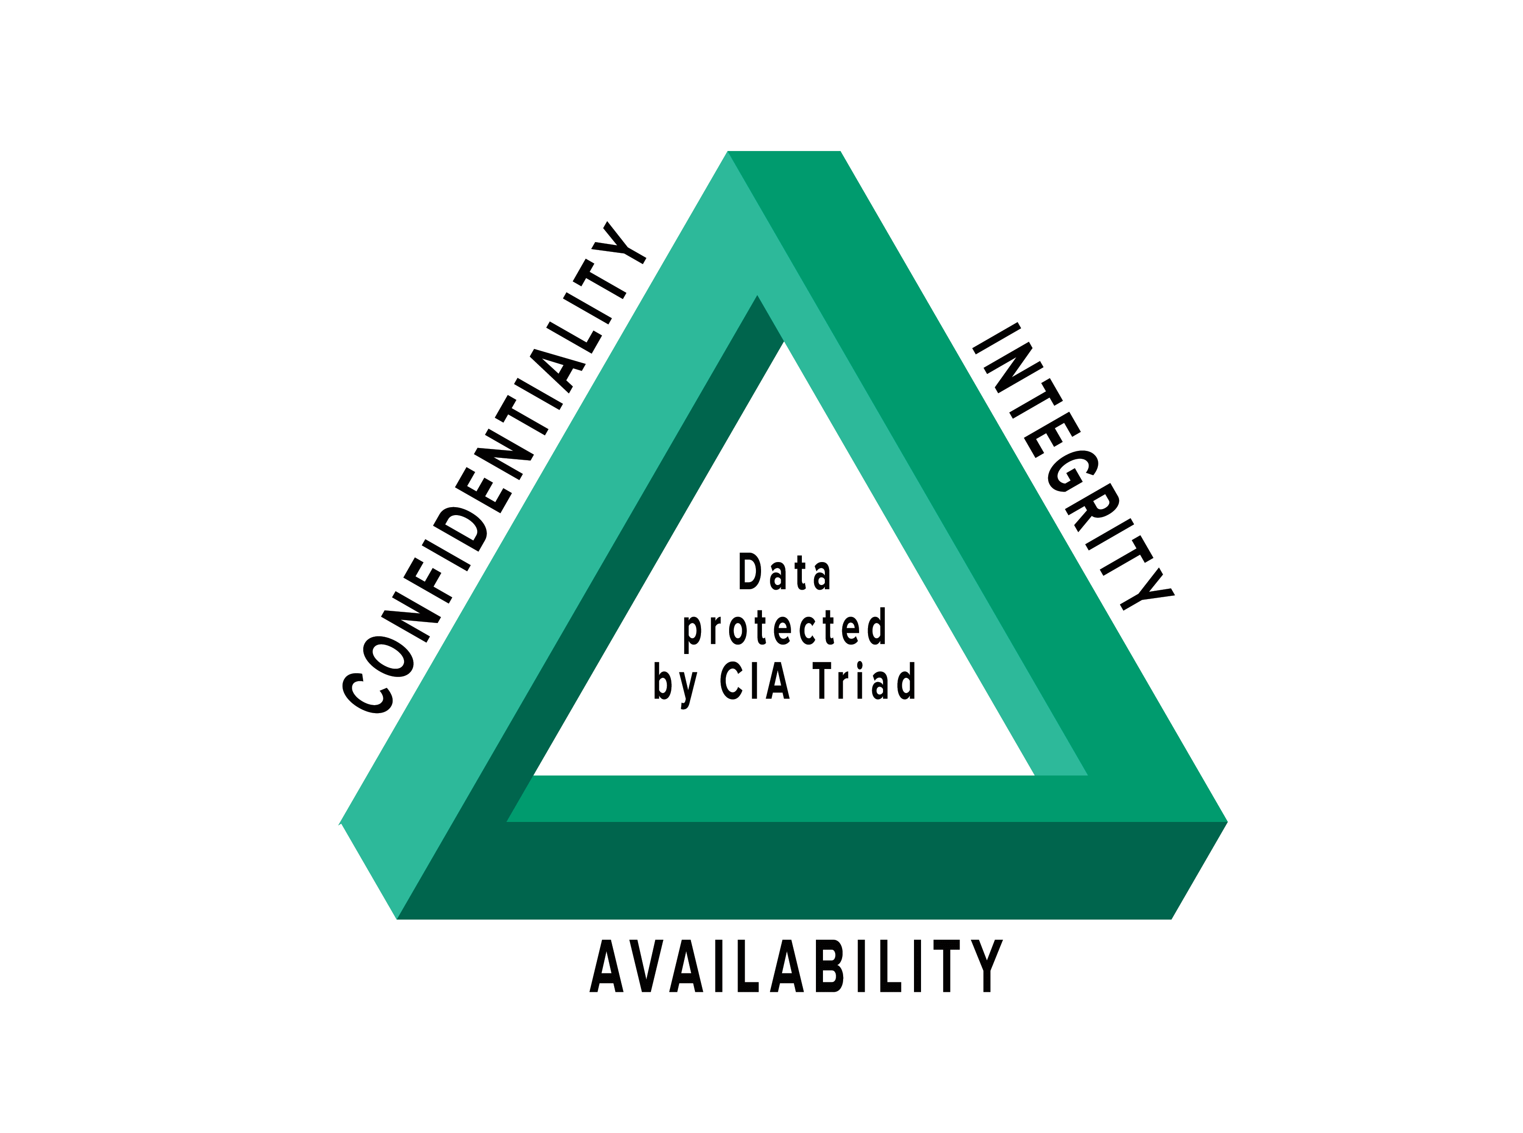
Cia triad

Slide 7
threats to data security
Malware
SQL INJECTION
Phishing
Denial Of Service (DOS) attacks
Weak Authentication
Unsecured Third Party Software
Human error
Cyberattacks

Slide 8
phishing
Phishing is a technique used by the cybercriminals into sharing sensitive information such as login credentials , credit card numbers , or personal information. Typically , phishing attacks are carried out through emails and instant messaging and they often include a link to a fake website that looks like a legitimate one. The user is asked to enter their login information and other sensitive data on this fake website which is often stolen by the data .

Slide 9
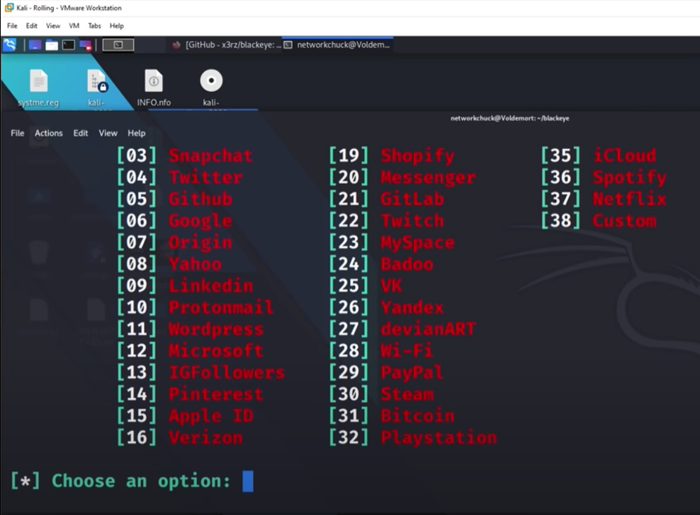
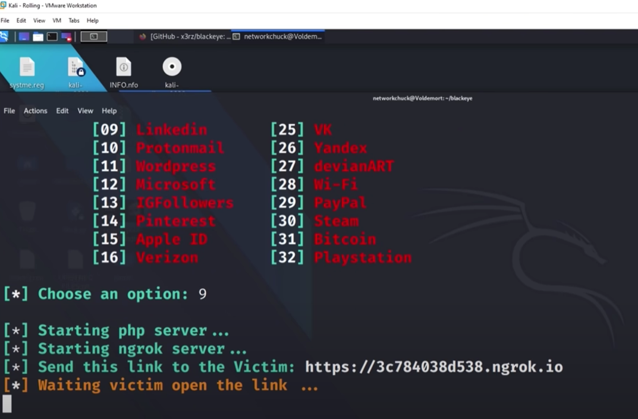
Steps involved in phishing

Slide 10
How to prevent phishing ?
Use strong and unique passwords and apply two factor aunthentication which adds an extra layer of security to your login process and makes it harder for attackers to gain access to your data.
Anti phishing softwares such as spam filters and antivirus programs to detect and block phishing attempts.
Keeping your web browser , operating system and emails up-to-date.
Look for the signs of phishing such as misspelled words , suspicious URLs, and unexpected attachments and links.

Slide 11
Preventing phishing via seo
Another important technique to reduce the risk of phishing attacks is to use SEO (Search Engine Optimization) using which we can actually reduce our net number of search results from millions to few hundreds by mentioning the exact domain of the website we want to browse . It also involves the use of certain keywords that are mentioned in the metadata of the desired domain.
Some of the operators used for SEO are :-
site:domain_name
site:domain_name intext:keyword
site:domain_name inurl:keyword
site:domain_name filetype:desired_file_format

Slide 12
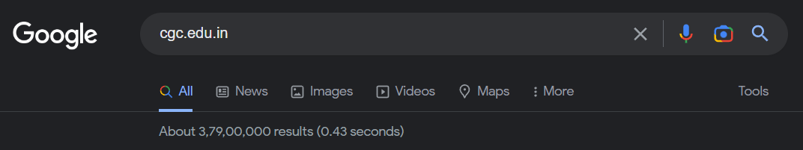
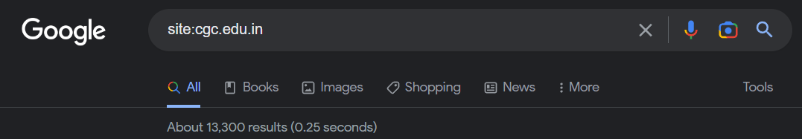
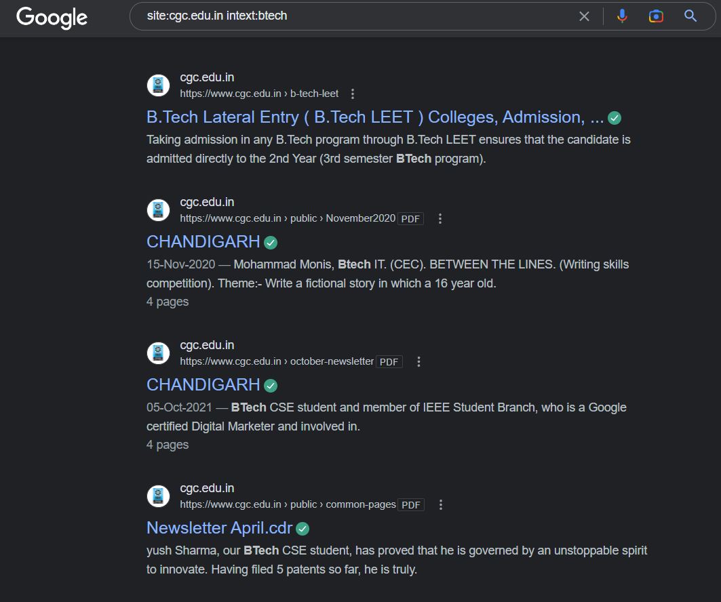
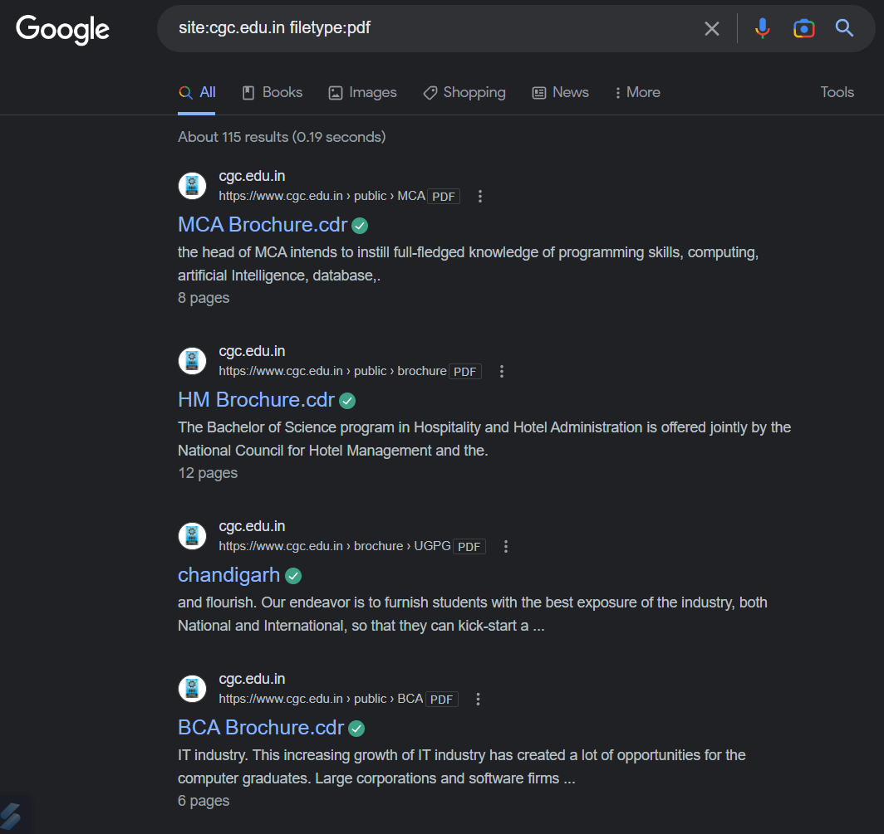

Slide 13
Denial of service attack
A Denial of Service (DoS) attack is a type of a cyber attack that is designed to disrupt the normal functioning of a website , server , or network by overwhelming it with a flood of traffic or requests. The goal of a DoS attack is to make the targeted resource unavailable to legitimate users , thereby causing inconvenience or even financial damage to the owner of the resource .
There are several types of DoS attacks some of them are :-
Network flood attack
Application layer attacks
Distributed Denial-of-Service attacks

Slide 14
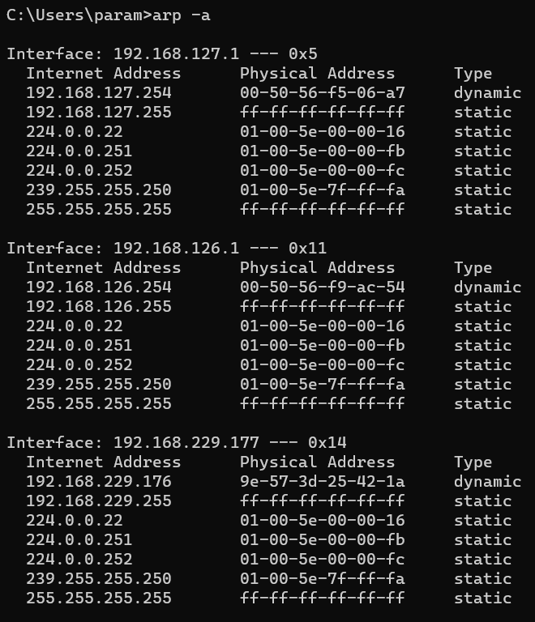
DETECTION OF HOST IP ADDRESS

Slide 15
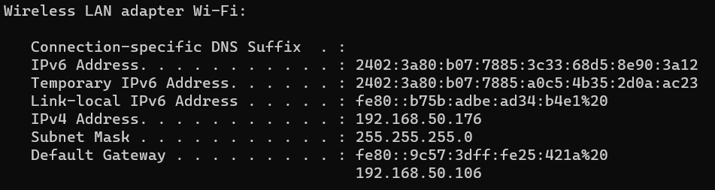
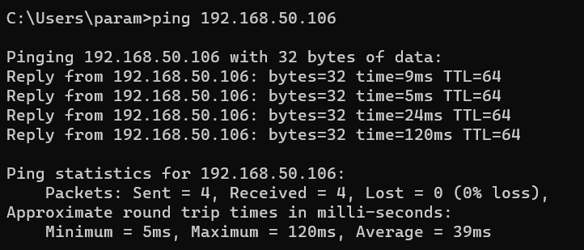
Steps involved in Denial of Service attack

Slide 16
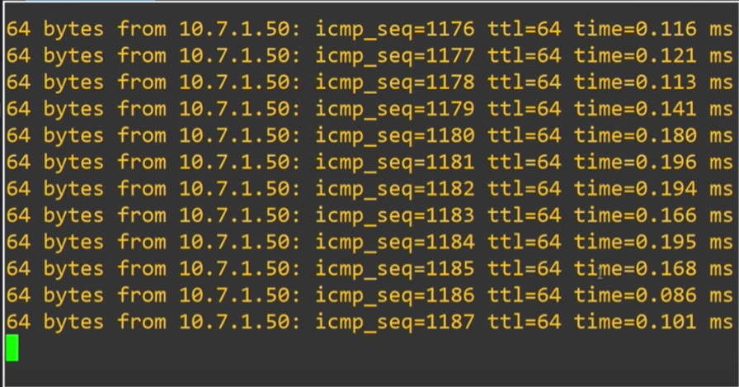
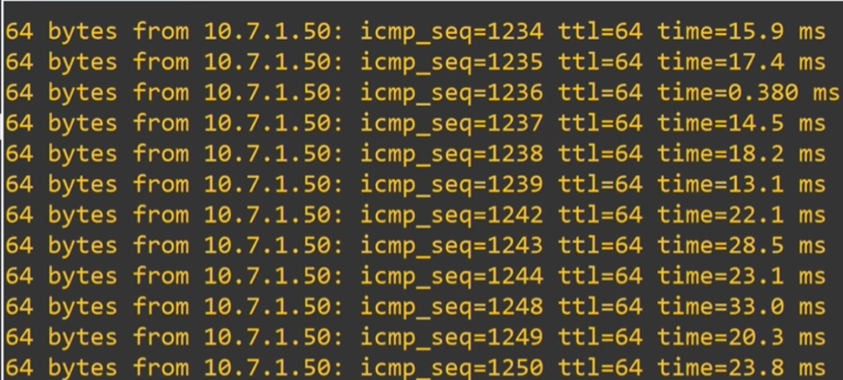

Slide 17
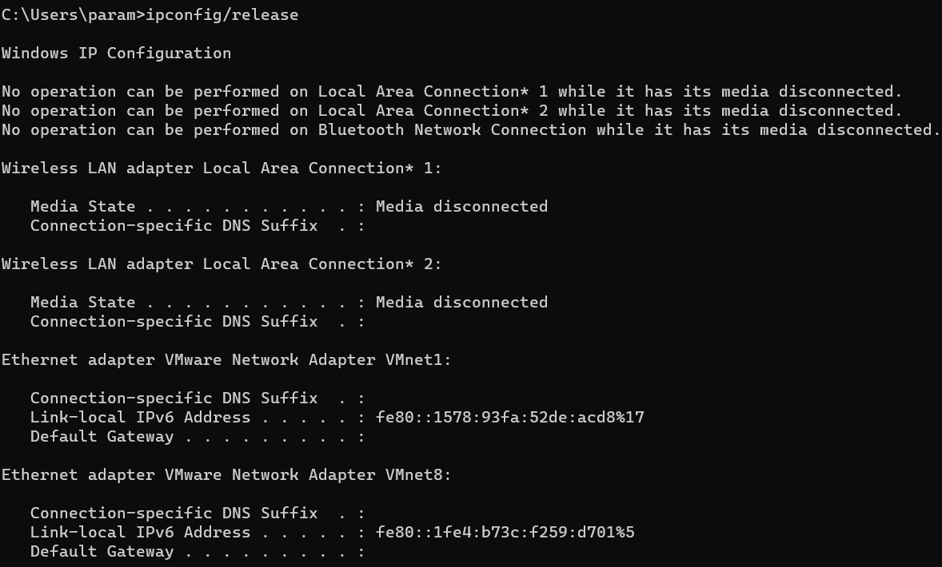
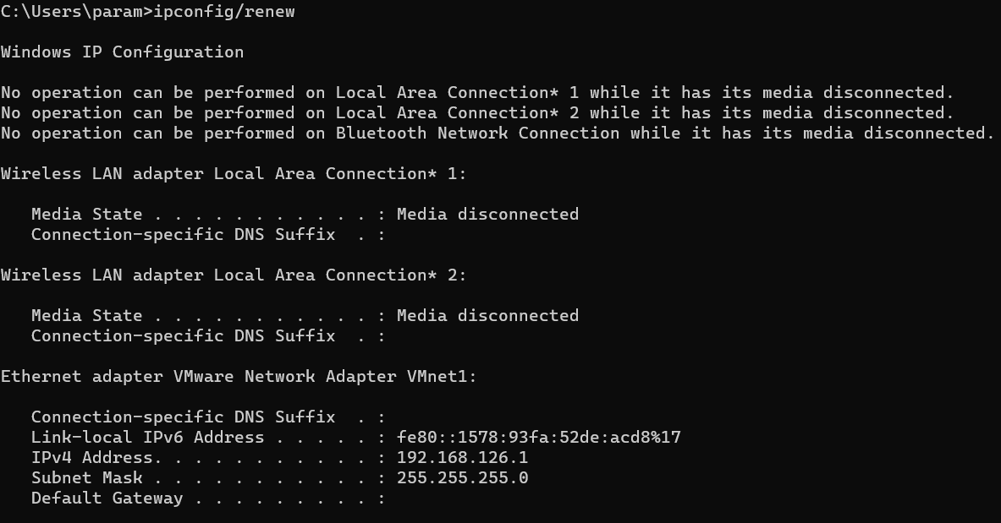
Preventing Denial of Service attacks
1. RELEASING AND RENEWING THE CURRENT IP ADDRESS

Slide 18
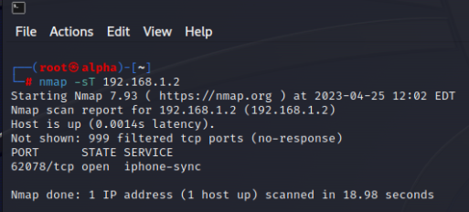
2. BUILDING SAFE FIREWALLS AND SCANNING VULNERABILITIES

Slide 19
Implementing a sql injection
NORMAL SQL QUERY TO LOGIN TO A DEVICE OR WEBSITE
select * from users where username = “admin” AND password = “Lab5”;
USING “OR” PAYLOAD IN SQL QUERIES
select * from users where username = “admin” OR ‘1’ = ‘1’ AND password = “Lab5”;
USING “COMMENT” PAYLOAD IN SQL QUERIES
select * from users where username = “admin” OR ‘1’ = ‘1’ -- AND password = “Lab5”;

Slide 20
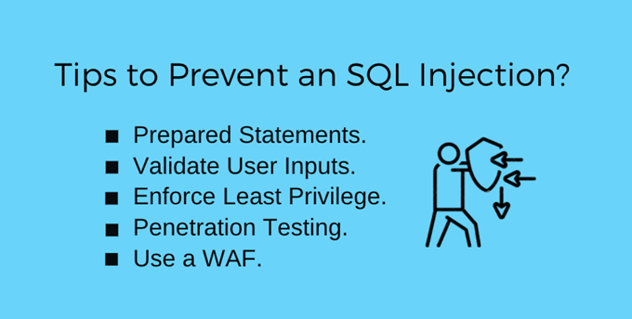

Slide 21
THANK YOU !!

